Slide 1
Evidence that the TOM cannot be right in all cases
Ulrich Schumann, Oct 2024
with one new slide as of 6 November 2024

Slide 2
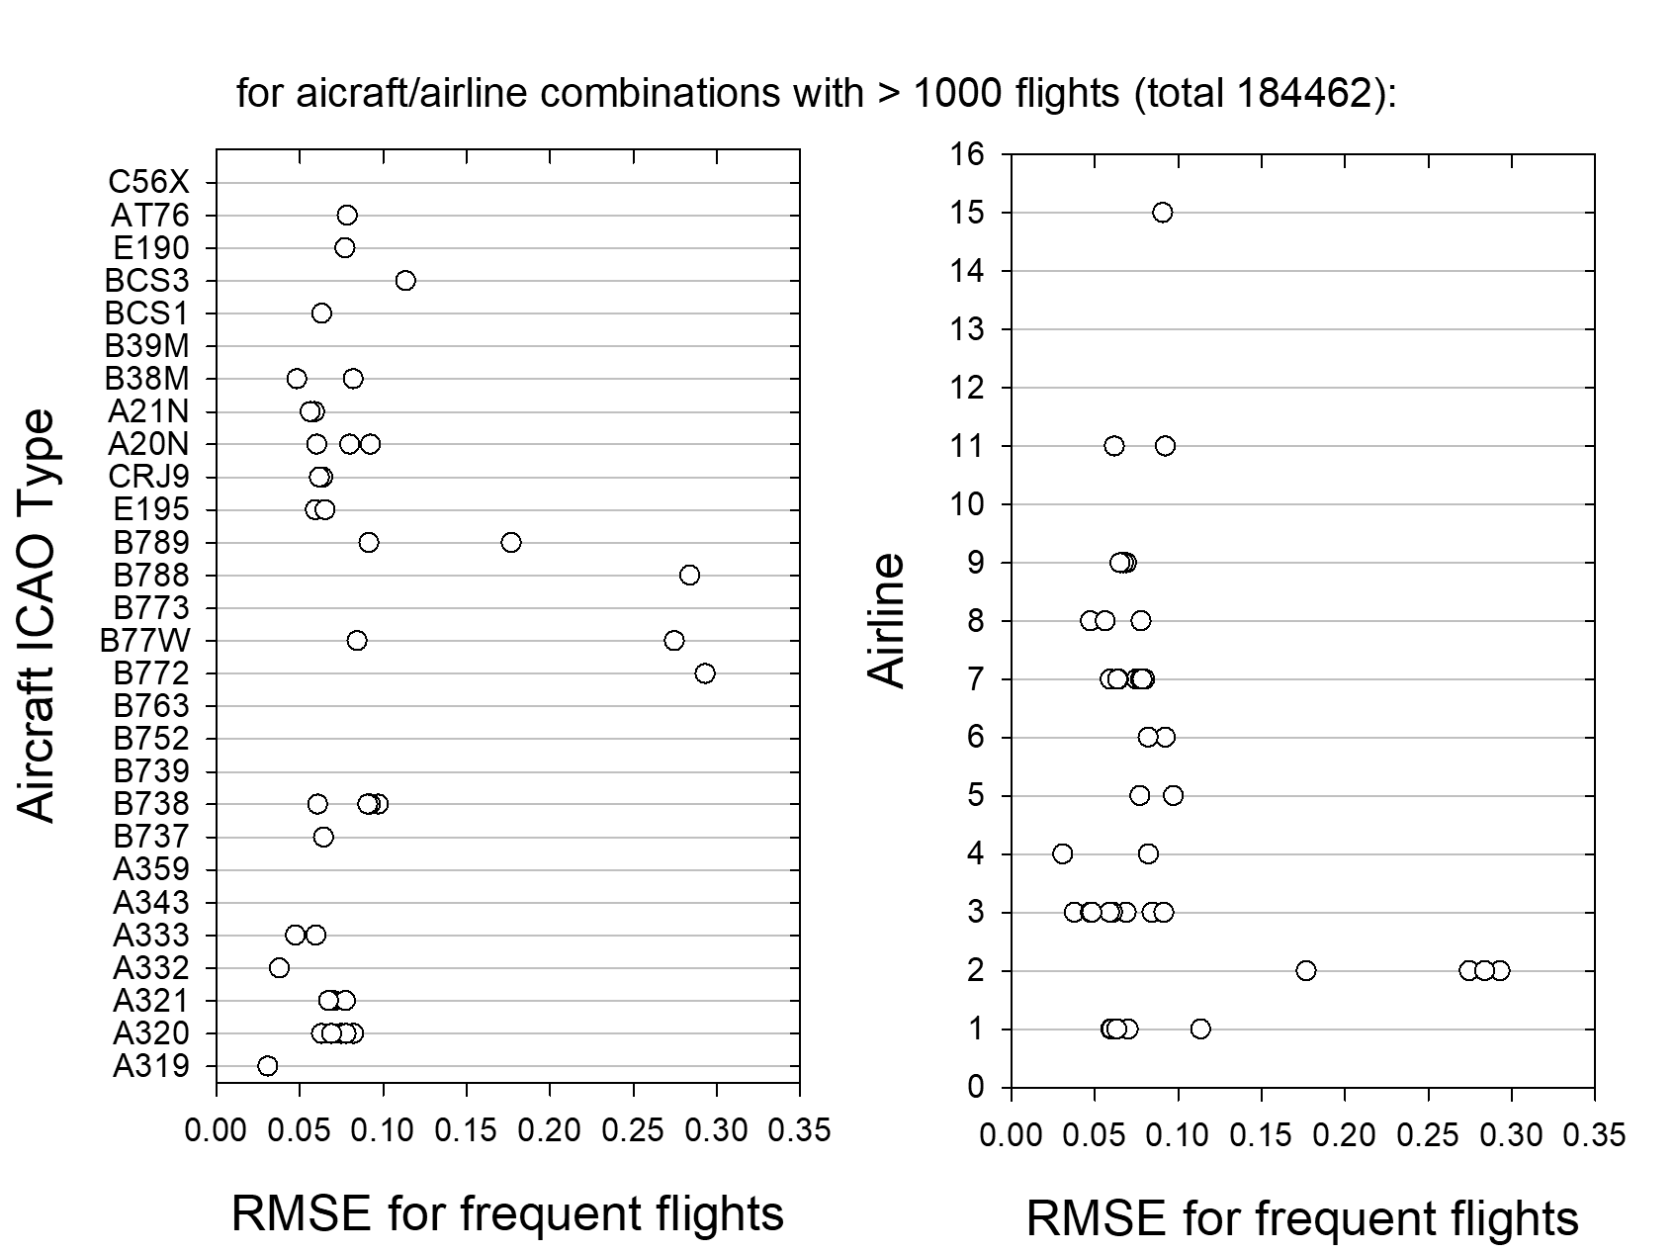
NEW (6 Nov 2024): Evidence that the TOM cannot be right in all cases – RMS errors versus aircraft type and airline number: One airline gives far large errors than all other
For some aircraft (e.g., B772, B77W, B788, B789), the relative rms error is far above others (partially >0.3)
But these large rms errors come from only one airline, here No. 2 (5543e4dc327359ffaf5b9c0e6faaf0e1)
The same aircraft types from airline No 3 (6351ec1b849adacc0cbb3b1313d8d39b) show far smaller rms errors (<0.1)
Omitting the results from airline No. 2 reduces the mean rms from 9.3 % to 7.2 %
These results were obtained by using one half of the challenge flights for calibration and the other half for computing the rms errors

Slide 3
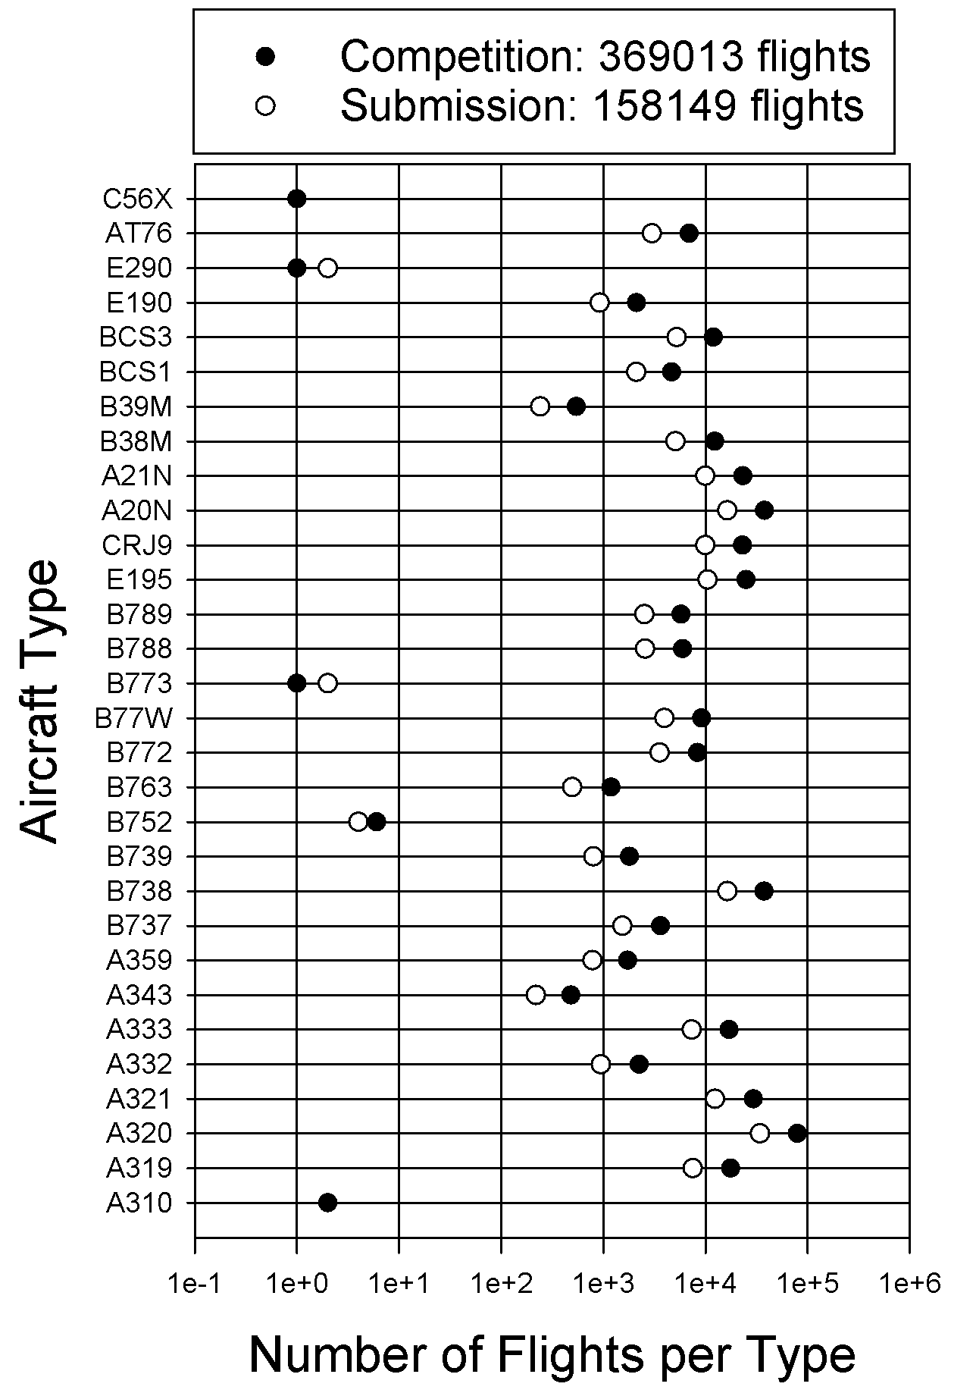
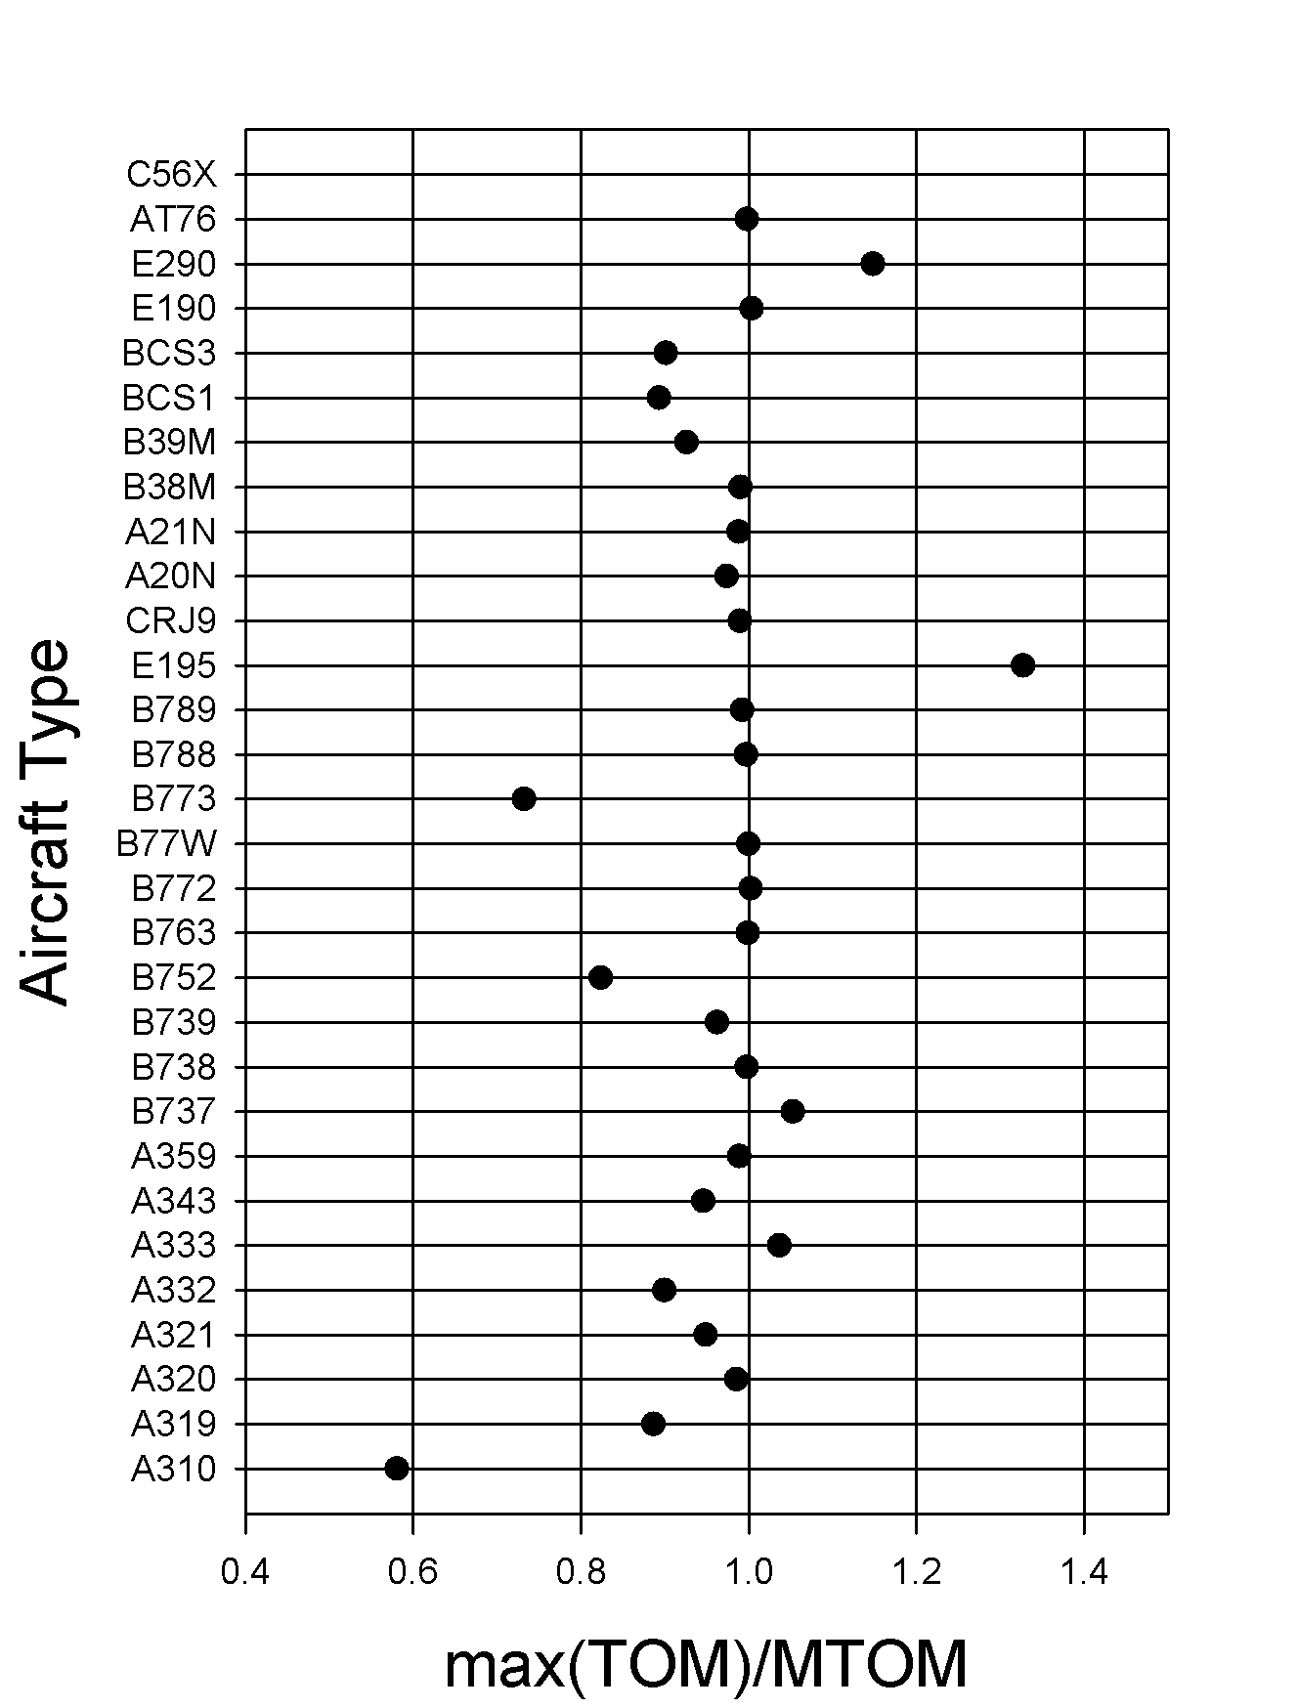
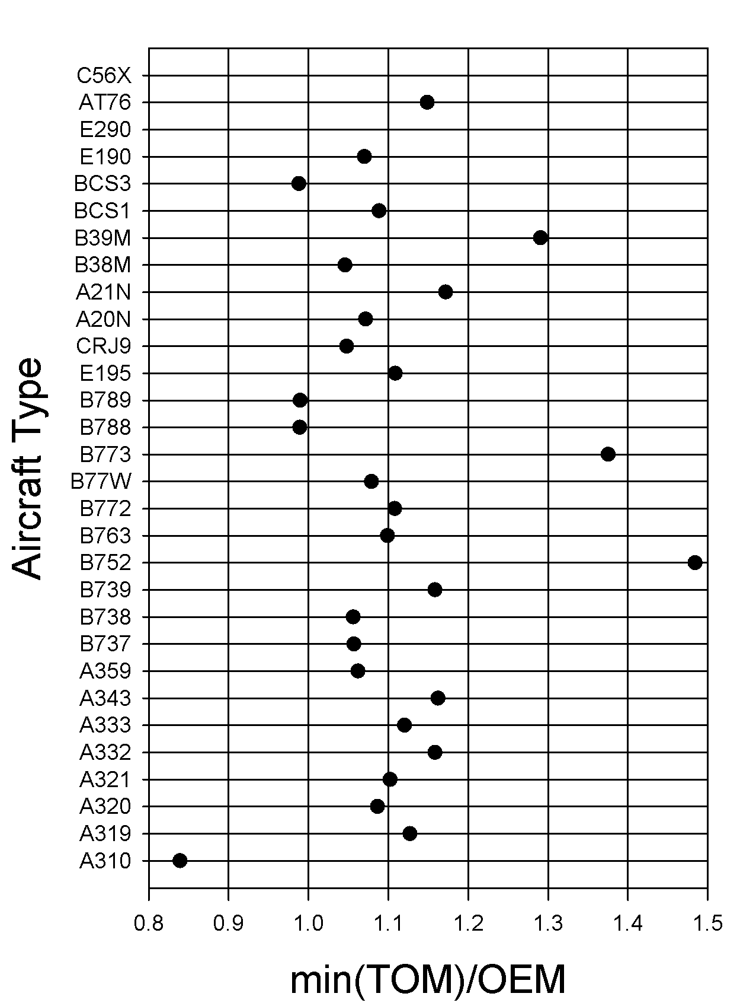
Evidence that the TOM cannot be right in all cases
For some aircraft (e.g. B773), the max(TOM) exceed our MTOM values
Others stay far below our data MTOM value (A310)
For further ones (e.g., A310), the min(TOM) reaches below the OEM

Slide 4
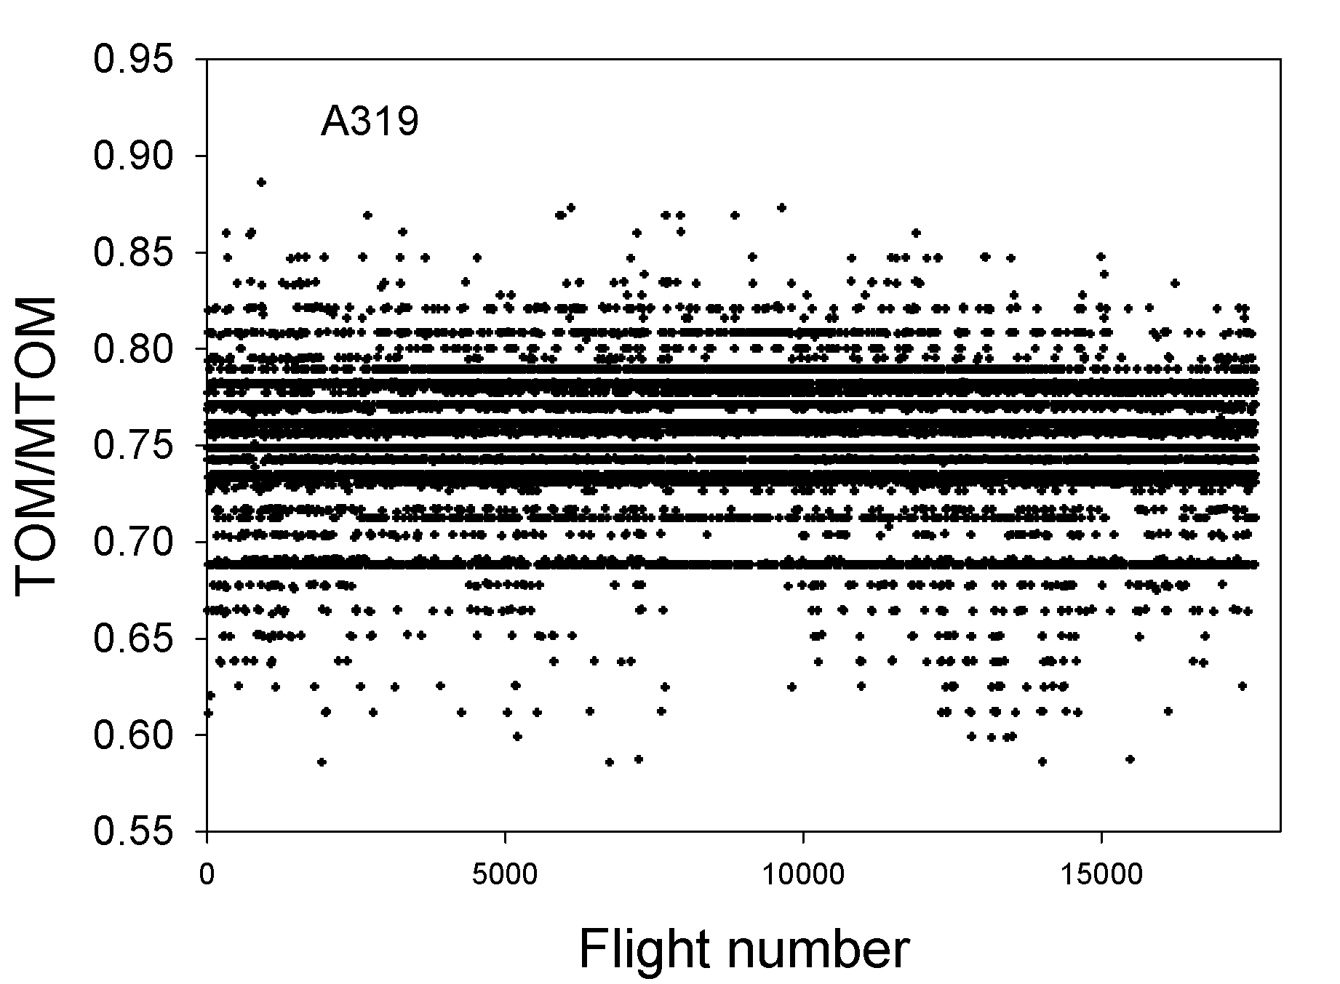
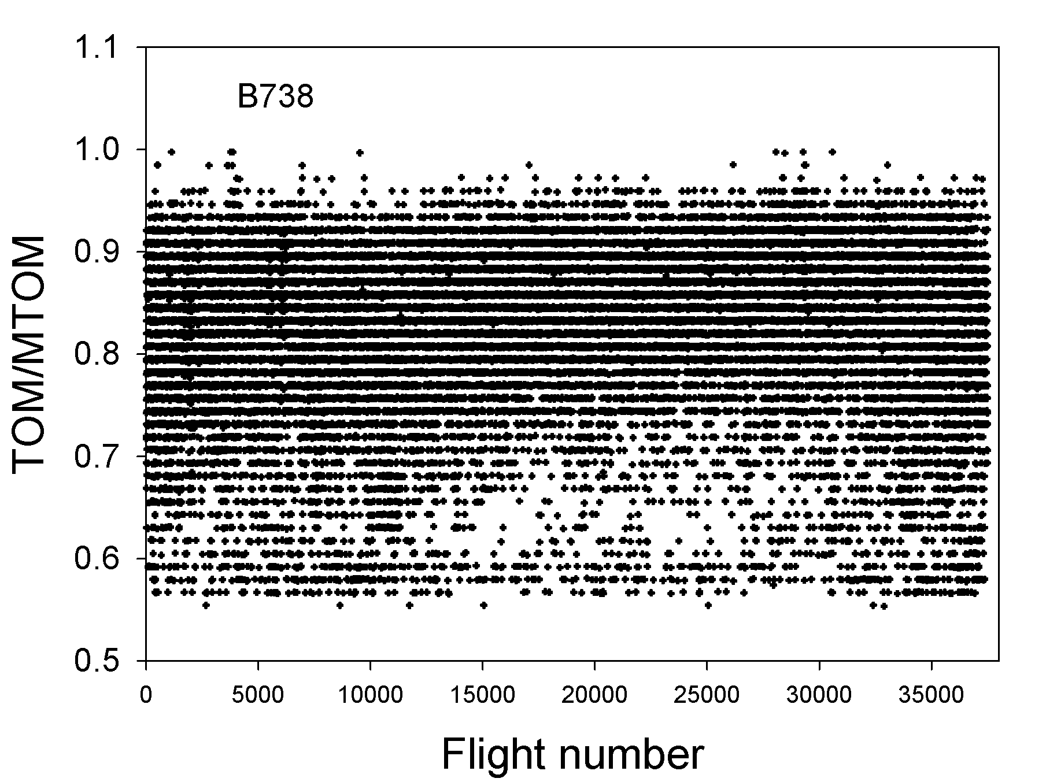
Evidence that the TOM cannot be right in all cases
For some aircraft (e.g. A319 ), the TOM is often close to specific discrete values constantly all over the year.
Others (e.g. the B738) do show far more variability and seasonal dependency .

Slide 5
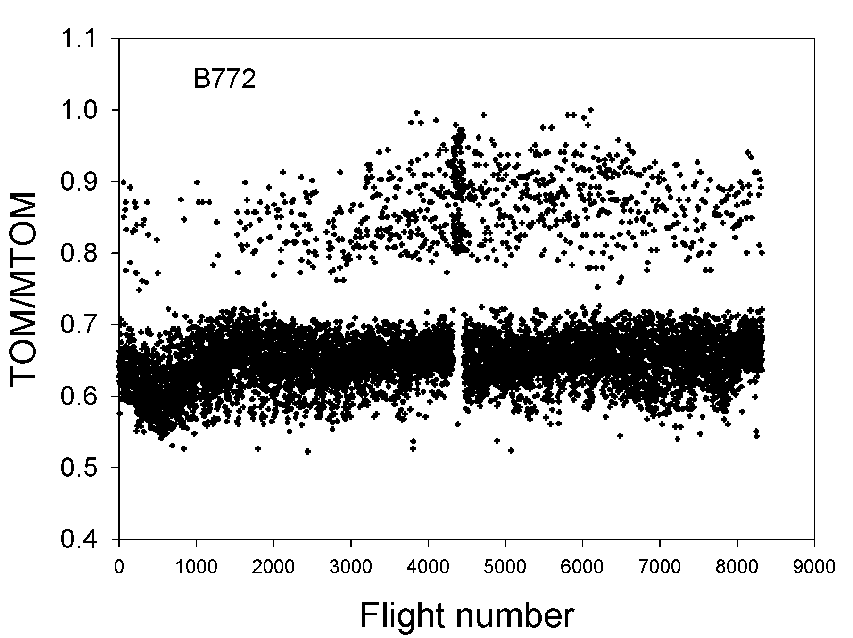
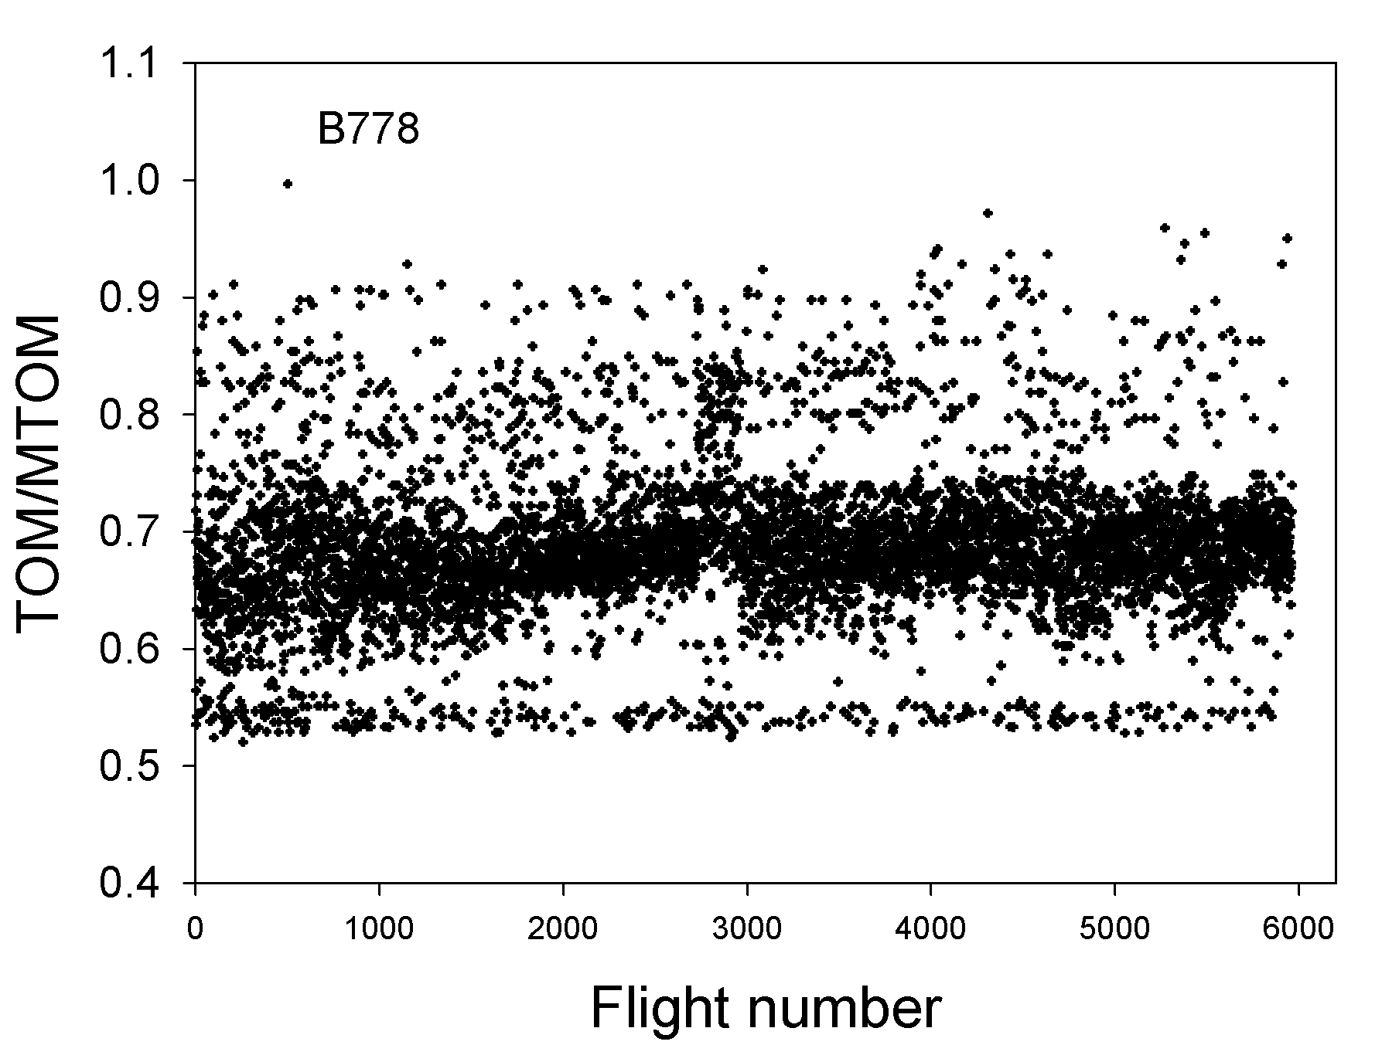
Evidence that the TOM cannot be right in all cases
For some aircraft (e.g., B772 and B778), the TOM is mostly very low, all over the year.
For these two aircraft the TOW derived from the load factor equation shows very large rms errors (about 25%).
The rms errors get reduced and reach an optimum of still 22 % when the only open model parameter (ηL/D)_{o} is increased by 12 %. from its best-estimate PS table value

